Slide 1
Chapter 14
How to add audio and video to your website

Slide 2
Objectives
Applied
Use the HTML5 audio and video elements to add audio and video to a web page.
Knowledge
Distinguish between these terms: media type, media player, and codec.
Explain why more than one audio or video type is required to run an audio or video file in all browsers.
In general terms, describe the coding that’s required for adding audio or video to a web page.

Slide 3
Common media types for video and audio
Video types
MPEG-4
Ogg
WebM
Audio types
MP3
AAC
Ogg
WebM
WAV
FLAC

Slide 4
Video and audio codecs
Video
H.264
Theora
VP8
Audio
AAC
FLAC
MP3
Opus
PCM
Vorbis

Slide 5
MIME types for identifying audio and video files\
MP3
AAC
Ogg Vorbis
WebM (Opus)
FLAC
PCM
MPEG-4
Ogg Theora
WebM (VP8/VP9)

Slide 6
What a media player does when it plays a video
Determines the media type that the user is attempting to play.
Determines whether it has the capability of decoding its video and audio streams.
Decodes the video and displays it on the screen.
Decodes the audio and sends it to the speakers.
Interprets any metadata and makes it available.

Slide 7
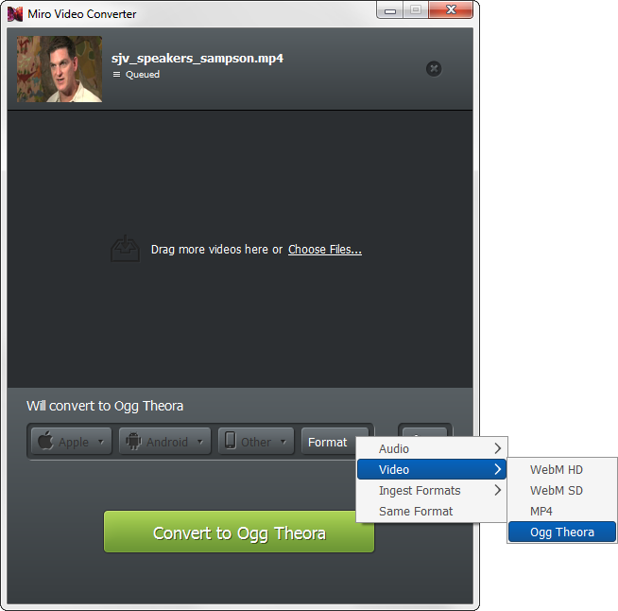
Miro Video Converter converting MP4 to Ogg Theora

Slide 8
The object and param elements
object
param
Attributes of the object element
type
data
width
height
Attributes of the param element
name
value

Slide 9
An object element for playing an MP4 file
<object type="video/mp4"
data="media/sjv_speakers_sampson.mp4"
width="480" height="270">
<param name="autoplay" value="true">
</object>

Slide 10
Attributes of the embed element
type
src
width
height

Slide 11
An embed element for playing an MP3 file
<embed type="audio/mp3" src="media/sjv_welcome.mp3"
width="300" height="25"
autoplay="true">
An embed element that plays a YouTube video
<embed src="https://www.youtube.com/embed/NkfJjWJnl-w"
width="560" height="349">

Slide 12
Common attributes for audio and video elements
src
poster
preload
autoplay
loop
muted
controls
width
height
The attributes for the source element
src
type

Slide 13
An easy way to add video or audio to a page
<video src="media/sjv_speakers_sampson.mp4"></video>
<audio src="media/sjv_welcome.mp3"></audio>

Slide 14
A video element for playing MPEG-4, Ogg (Theora), and WebM media types
<video id="videoplayer" width="480" height="270“
controls autoplay>
<source src="media/sjv_speakers_sampson.mp4">
<source src="media/sjv_speakers_sampson.webm"
type='video/webm; codecs="vp8, vorbis"'>
<source src="media/sjv_speakers_sampson.ogv"
type='video/ogg; codecs="theora, vorbis"'>
</video>

Slide 15
An audio element for playing MP3 and Ogg (Vorbis) media types
<audio id="audioplayer" controls autoplay>
<source src="media/sjv_welcome.mp3">
<source src="media/sjv_welcome.ogg">
</audio>

Slide 16
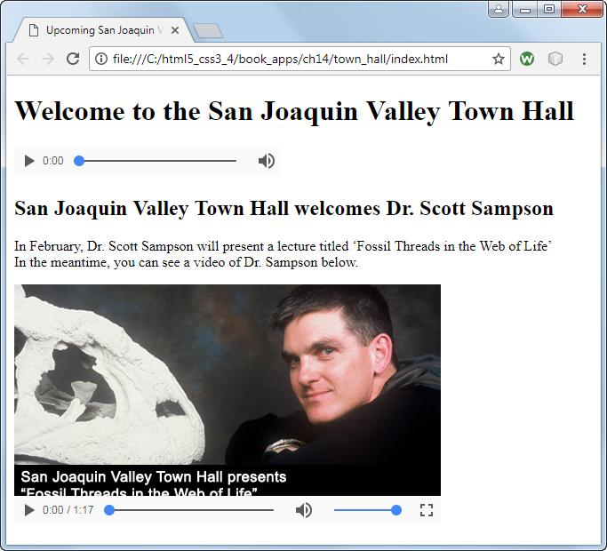
A web page that offers both audio and video

Slide 17
A page that has both audio and video elements
<main>
<h1>Welcome to the San Joaquin Valley Town Hall</h1>
<audio id="audioplayer"
src="media/sjv_welcome.mp3" controls>
</audio>
<h2>San Joaquin Valley Town Hall ...</h2>
<p>...</p>
<video id="videoplayer"
src="media/sjv_speakers_sampson.mp4"
controls width="480" height="270"
poster="images/poster.png">
</video>
</main>

Slide 18
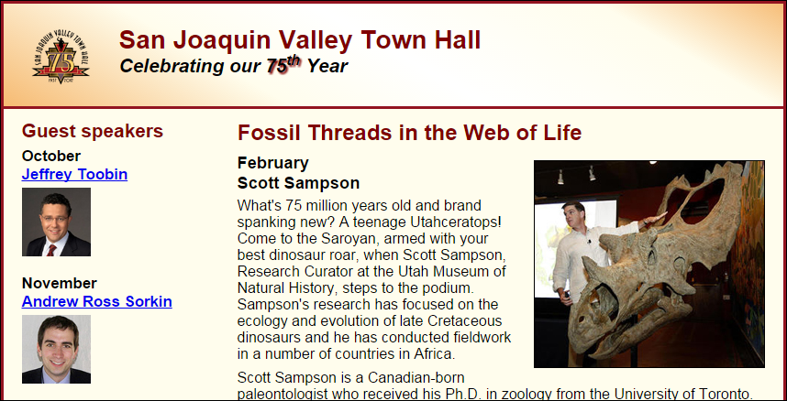
Short 14-1 Embed audio in a page

